Slide 1


Group 14
Hospital Management
System
DATABASE

Slide 2







Group 14
Meet
THE TEAM
Mohammed Anzal Zafar Shaikh
Sahil Ajay Ruparelia
Yashraj Kadam
Sohni Rais
Sushil Girish
002271996
002853503
002830773
002817666
002815597

Slide 3

PROBLEM STATEMENT
In the rapidly evolving healthcare sector, hospitals face significant challenges in managing vast amounts of data related to patients, staff, departments, and medical services. The absence of a centralized, efficient, and robust data management system leads to operational inefficiencies, data mismanagement, and a decline in patient care quality.

Slide 4
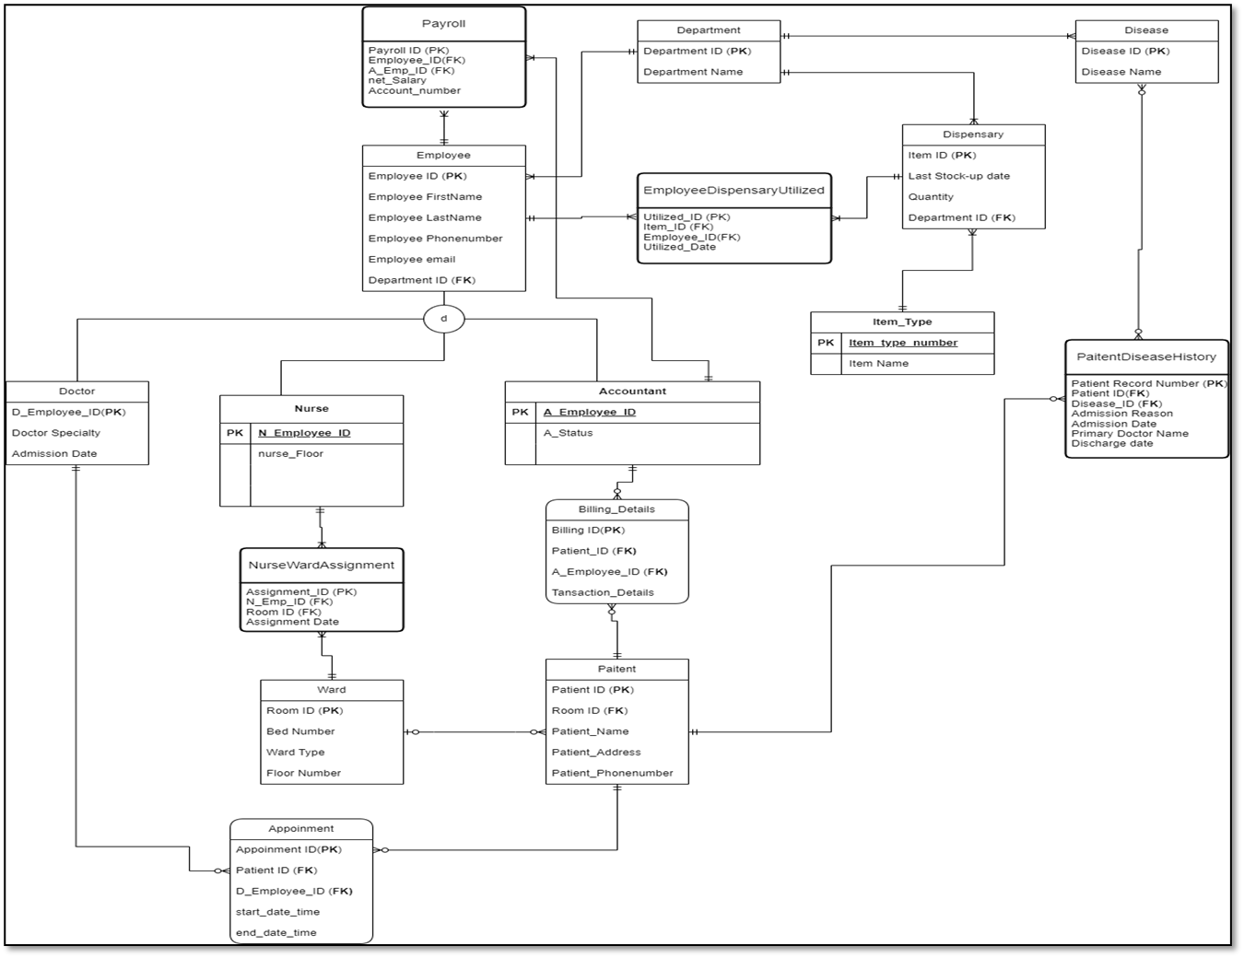
EER
DIAGRAM

Slide 5
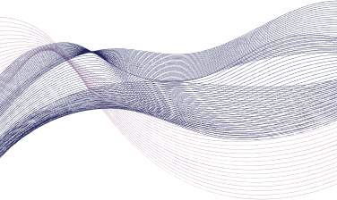
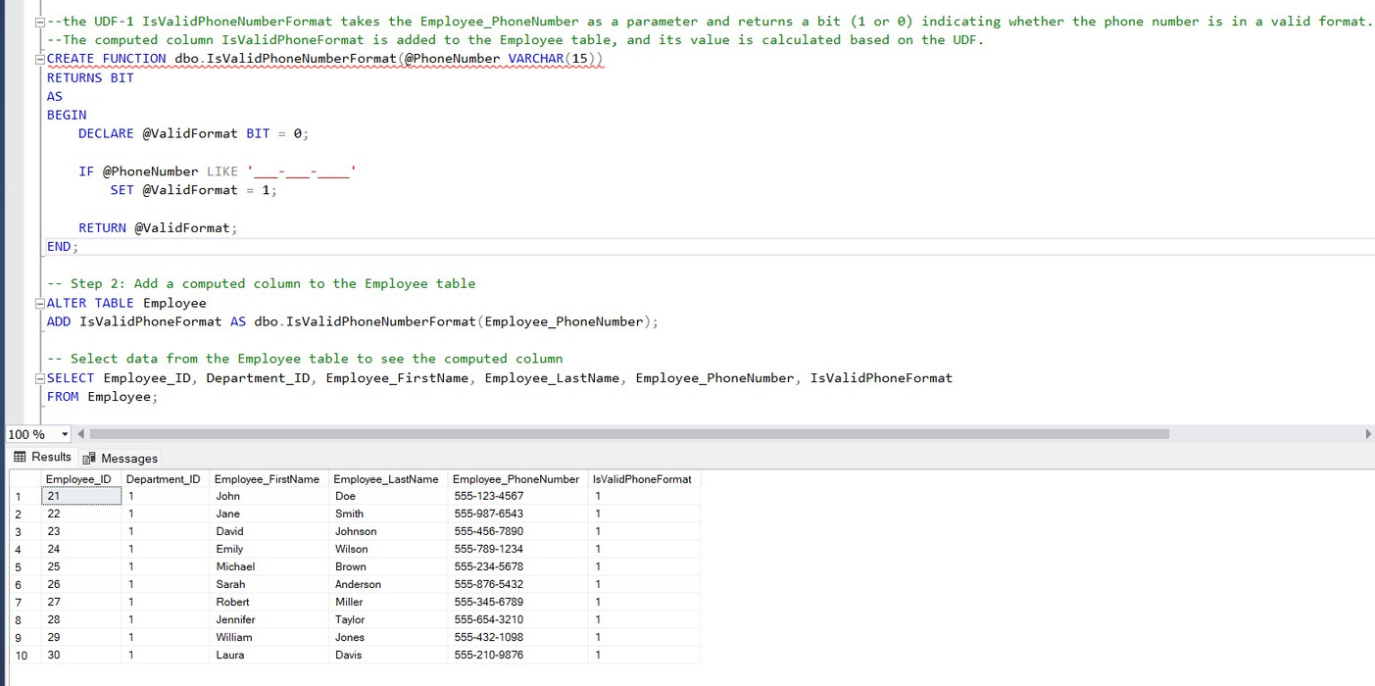
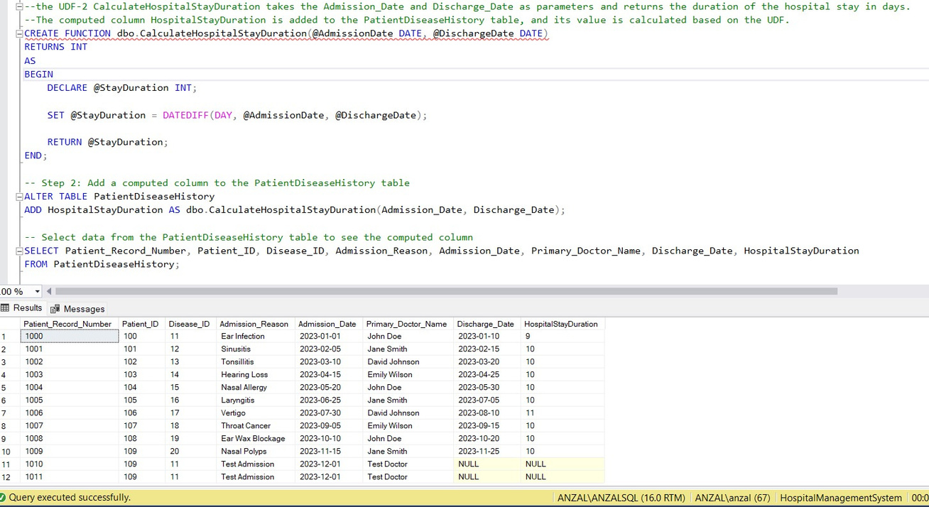
Functions

Slide 6
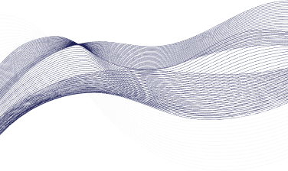
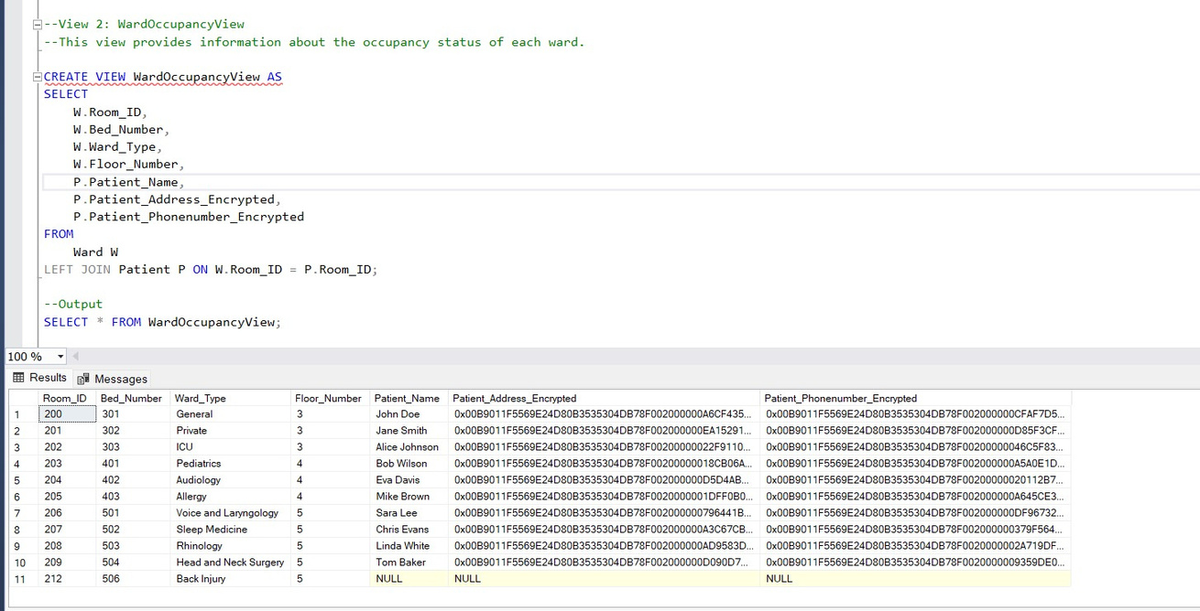
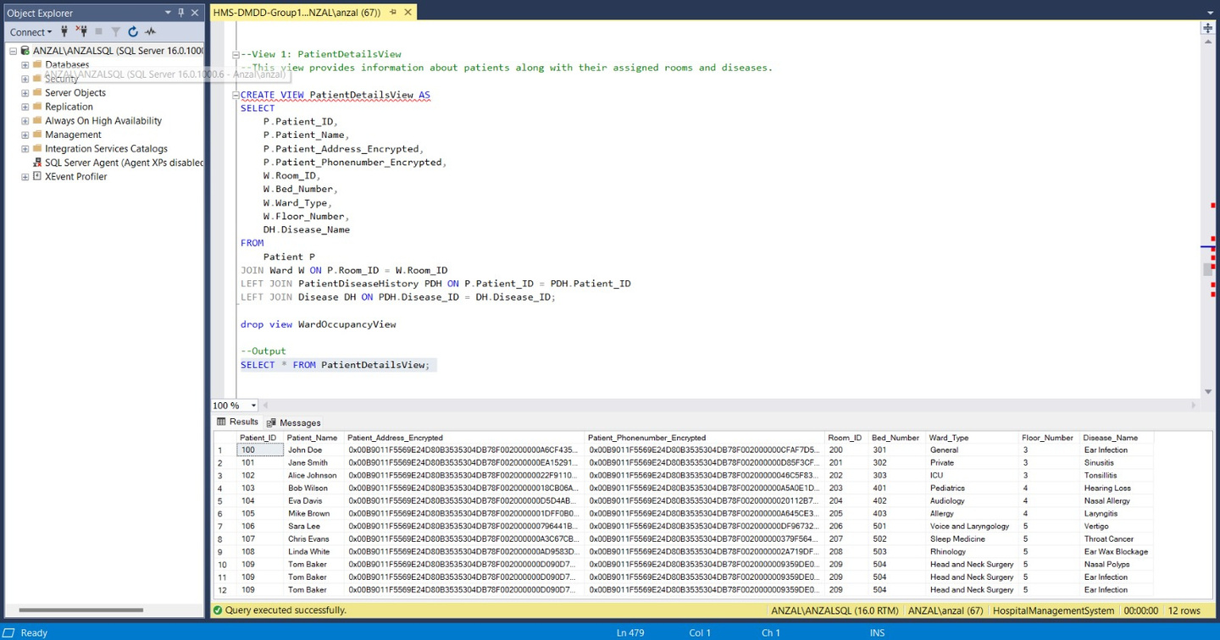
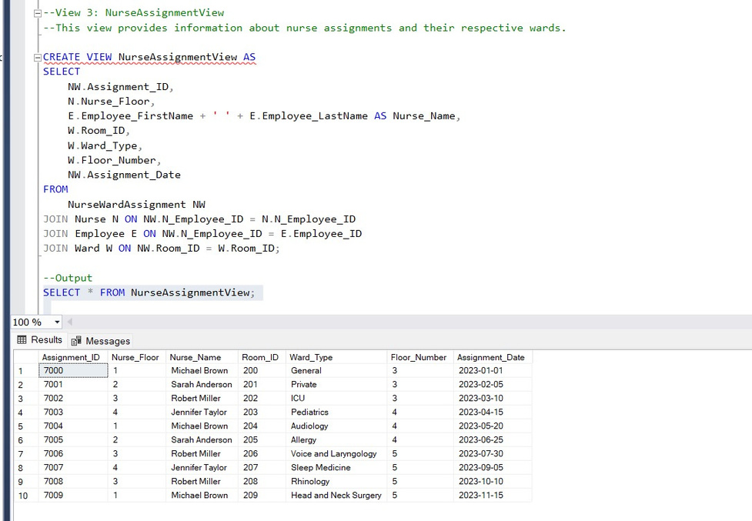
Views

Slide 7

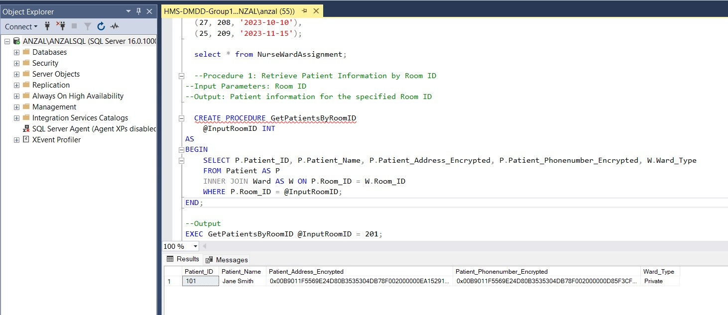
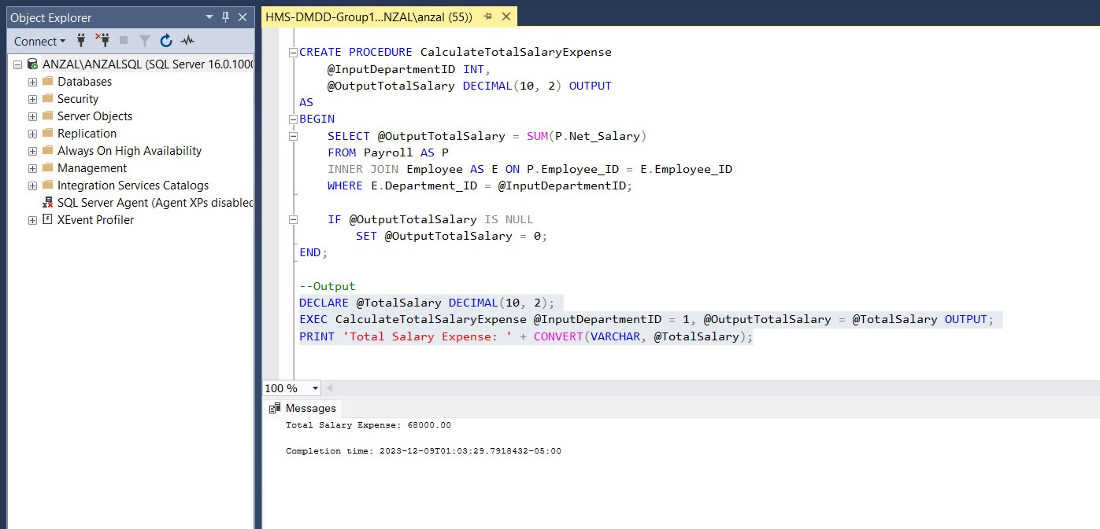
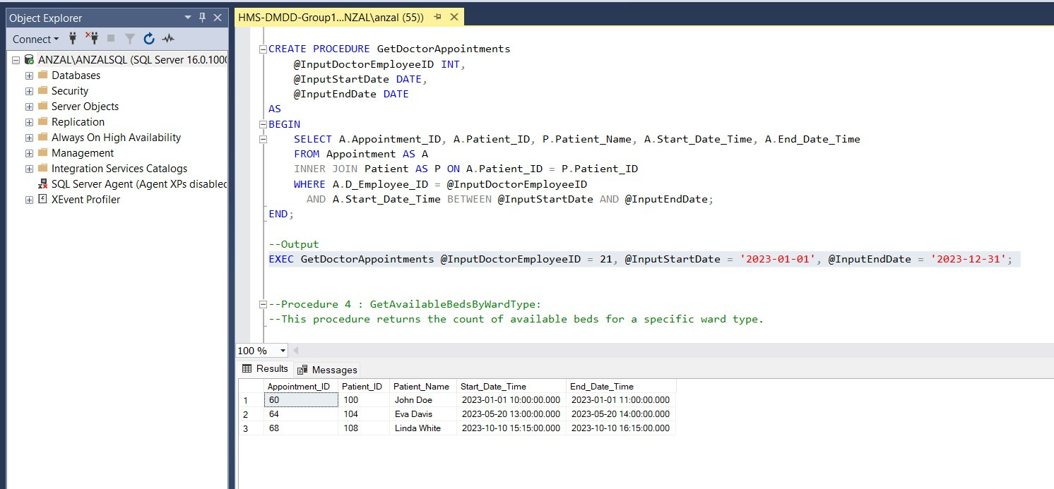
Procedures

Slide 8
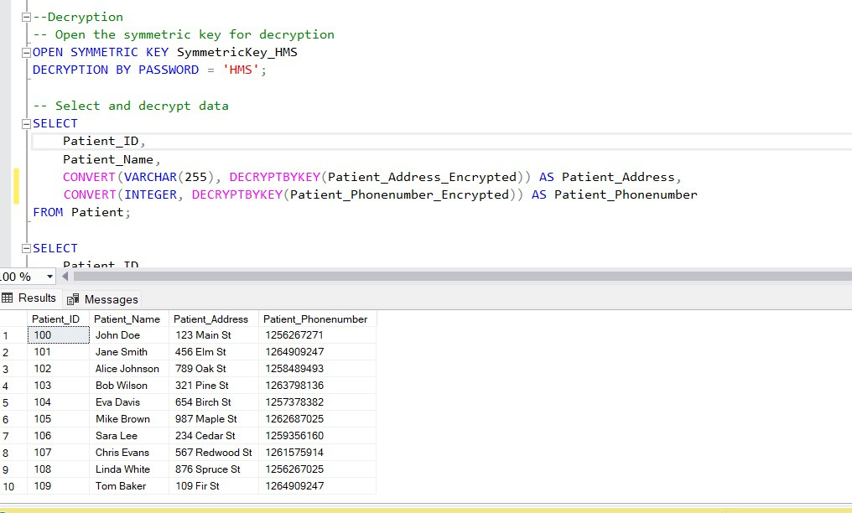
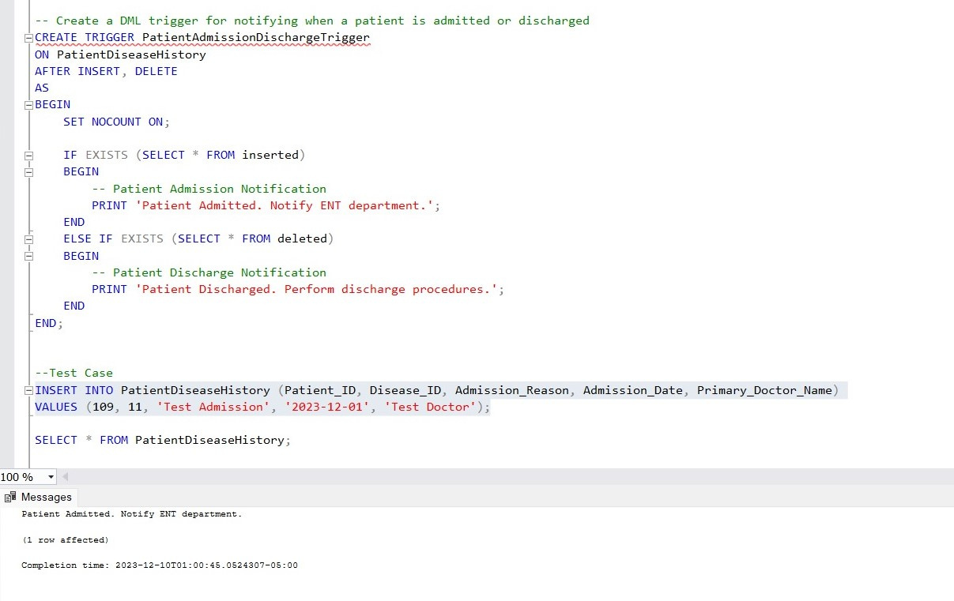
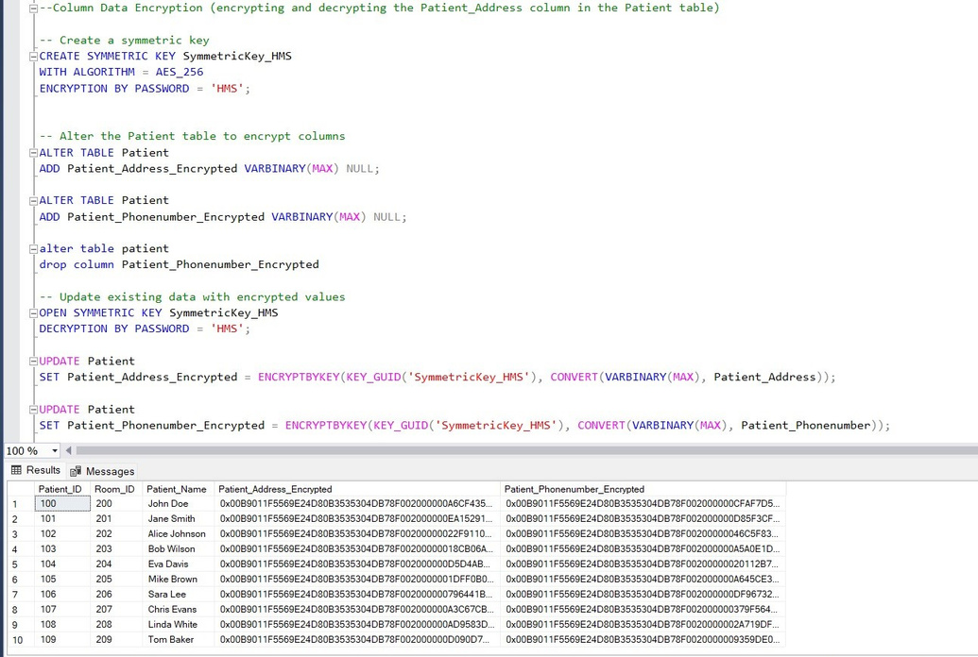
Trigger
Decryption
Column Encryption

Slide 9

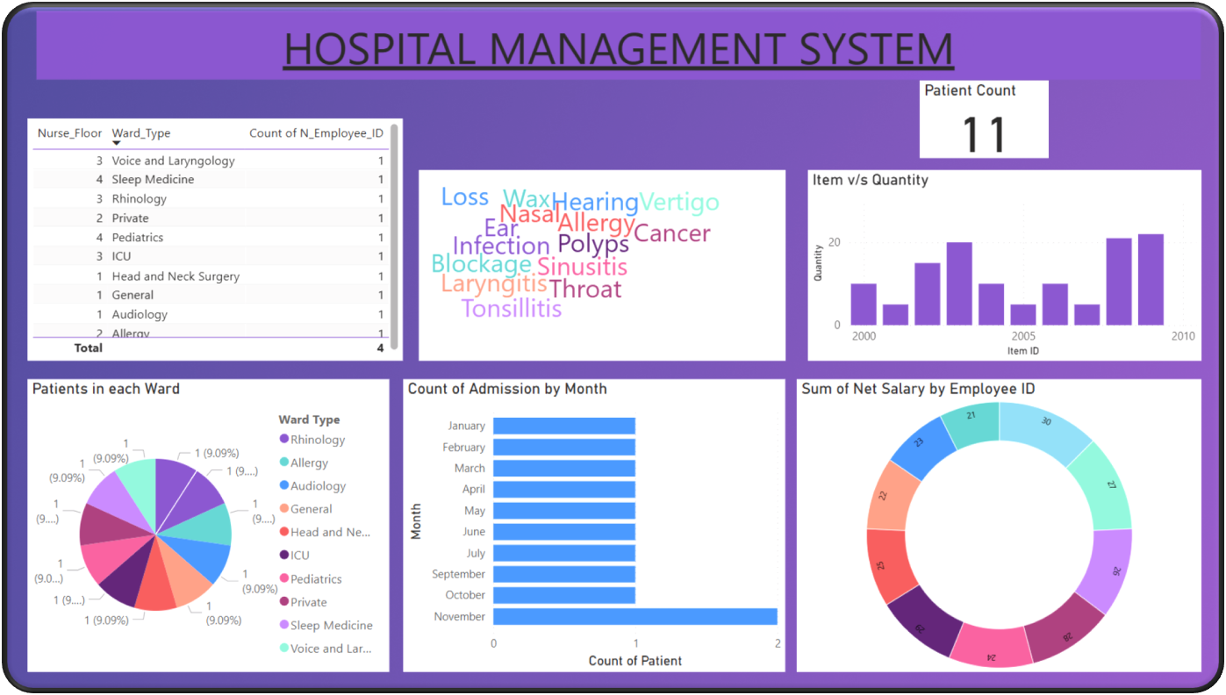
Power BI

Slide 10
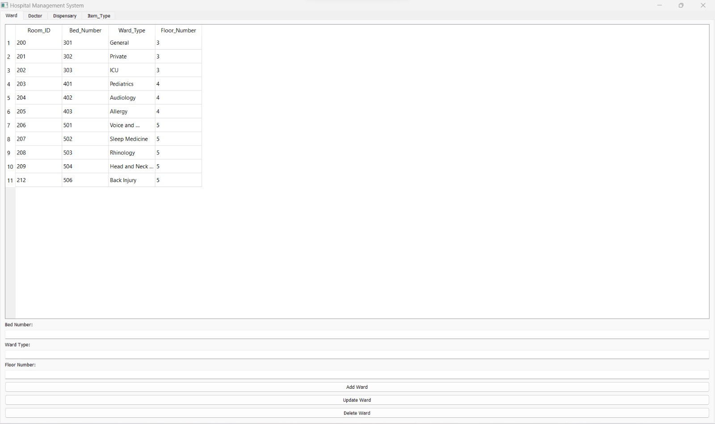
GUI for CRUD Operations using python

Slide 11
Group 14
THANKYOU!

